Slide 1


Our Project.
Team DFJ.
David, Fidel, Jane
G-Research

Slide 2

Contents.
01.
How We Formed Our Strategy
02.
Development Process
03.
Programming
04.
Signal Generation
05.
Testings / Results
06.
Insights / Conclusion

Slide 3

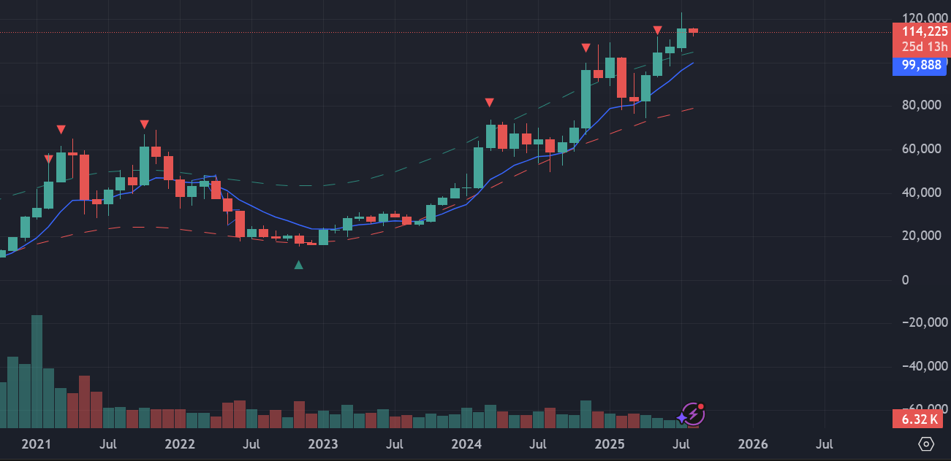
How We Formed Our Strategy.
Looked at TradingView with Indicators
Discovered Simple Moving Average + Support / Resistance
lines
Support/resistance lines limited (as static) and SMA slow
to respond to market - signal delayed
Researched Exponential Moving Averages, Bollinger bands,
and mean reversion - Z-Score

Slide 4
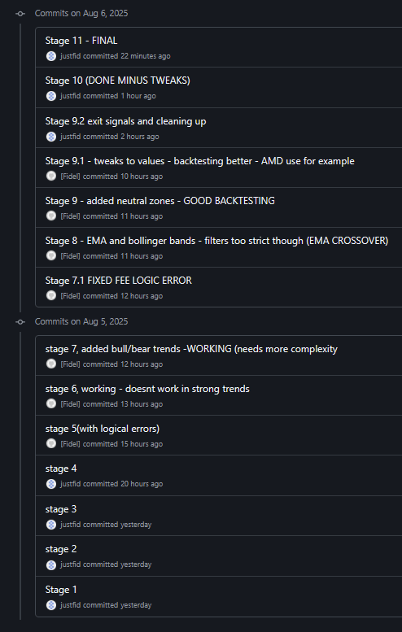
Our Development Process.
Our Approach:
Used a GitHub repo to collaborate - version control
Developed incrementally
Started with EMA & Graph, added features 1 at a time while testing
Ran into issues like negative balances, lack of signals
Main Technologies used:
Pandas: Analysing, cleaning and manipulating data
Plotly: Representing data

Slide 5
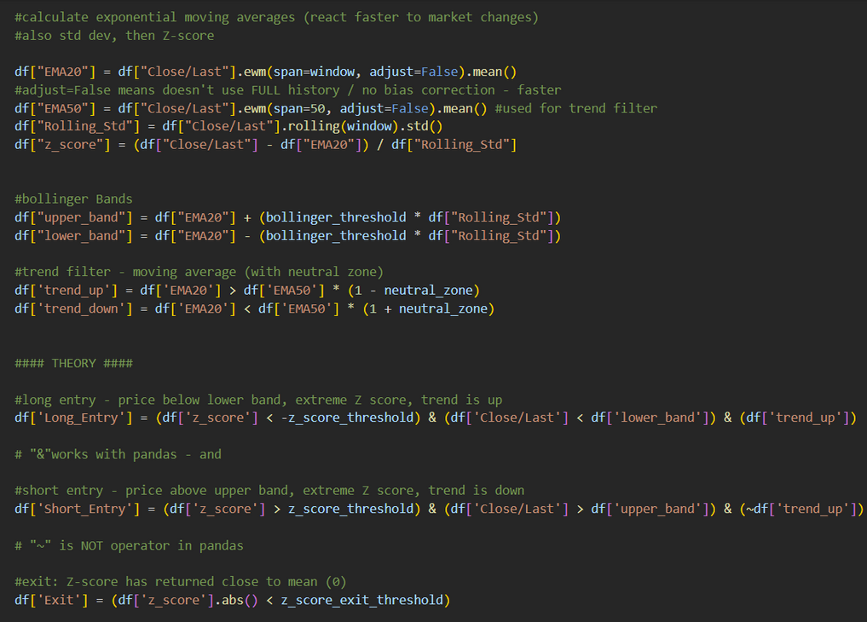
The programming phase.
Statistical analysis - Algorithms for mean reversion (with Z-Scores), Bollinger bands, EMA (Short and Long Term)
Trading Strategy - Mix of factors: Extreme Z score, price outside Bollinger Band, EMA crossover for trend detection
Simulation - Executing trades according to signals
Parameters - Tweaking inputs to function to maximise profit (E.G. window length for EMA and Z-Score thresholds
Graph + Tables - Candlestick graph used to visualise strategy + signals. Other graphs / tables track portfolio value, profit, sharpe ratio

Slide 6
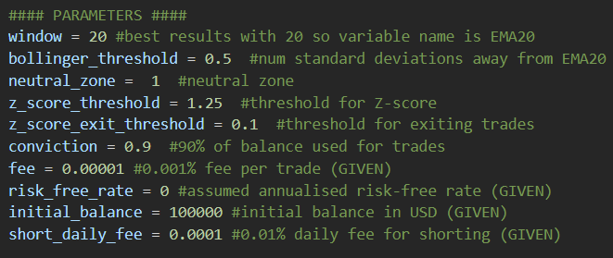
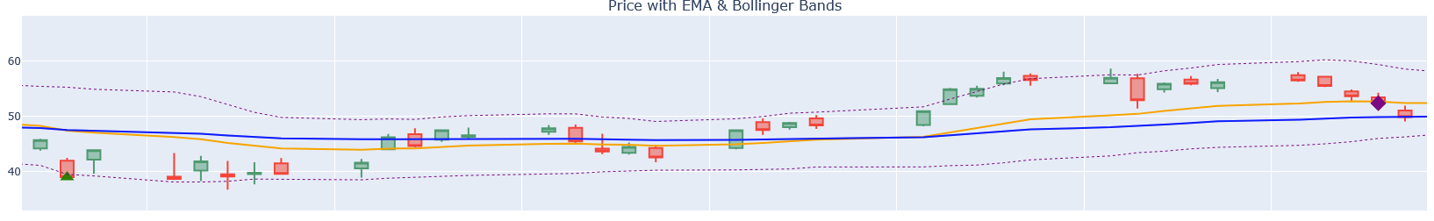
Generating Our Signals
Conditions:
Extreme Z-Score ( > |1.25|)
Right Market Conditions (E.G. Uptrend for buying) - calculated using EMA crossover
Outside Bollinger Bands ( > |0.5|)
All 3 have to be true for signal - reduces noise

Slide 7
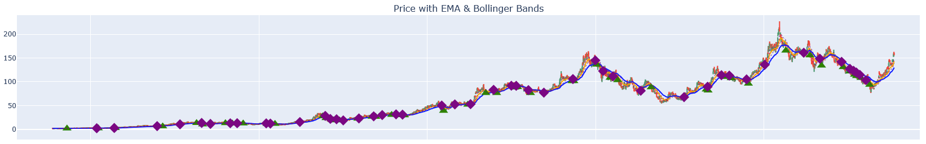
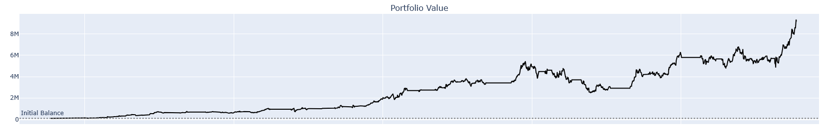
Testing + Our Results.
We back tested our strategy throughout the whole process, using each stock’s 10-year historical data

Slide 8
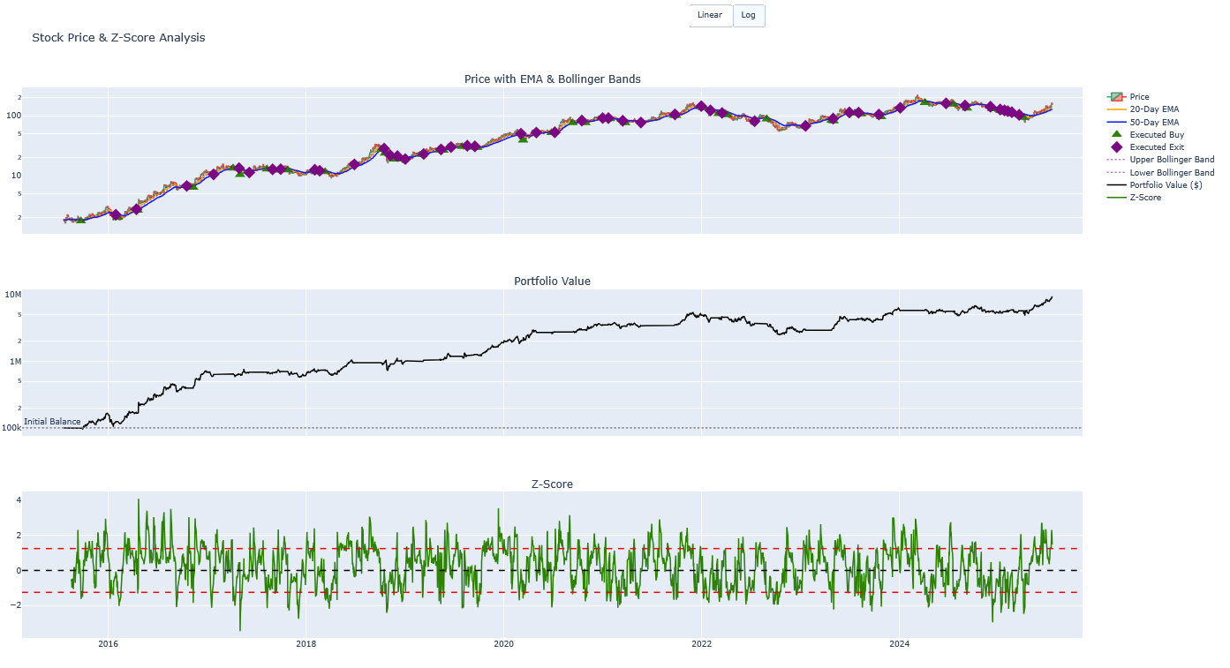
Testing + Our Results.

Slide 9
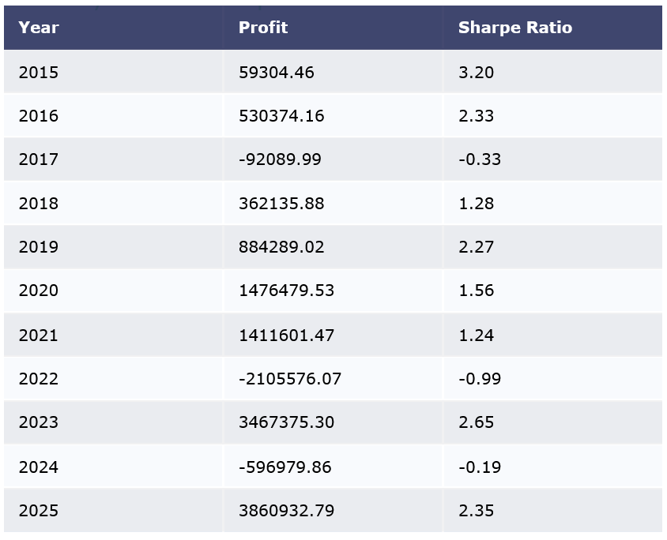
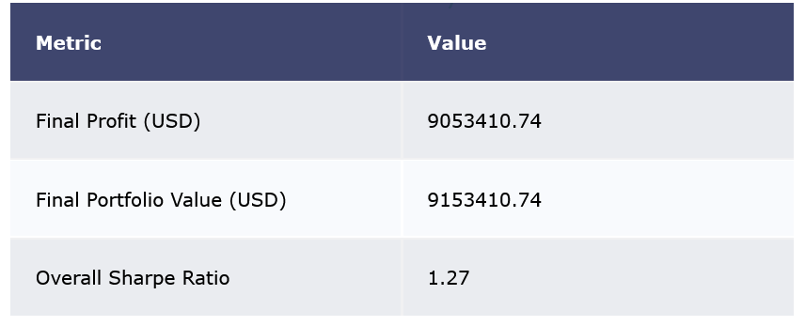
Testing + Our Results.
Using AMD stock, we turned the starting 100k into ≈ 9M
with an overall sharpe ratio of 1.27

Slide 10
Our Insights + Conclusions.
Challenges We Faced & Lessons Learned:
Starting from a blank slate - researching new financial concepts
Building a detailed & accurate simulation (E.G. taking fees into account)
Generating signals that were not too strict or lenient
Navigating new data structures within Pandas Library (E.G. Dataframes)
If We Had More Time:
Build a stop loss system to prevent large losses
Expand on strategies used (E.G. ATR for volatility)
Add support for multiple stocks at once

